Slide 1
Render Graph
One step more to the modern rendering architecture
Tianyi(Tanki) Zhang

Slide 2
auto& genBufferPass = mGraph.defineNode(
"G-Buffer",[&](RenderNodeContext& builder) {
S<const Program> prog = Resource<Program>::get(“…");
builder.reset(prog);
builder.readCbv("frame-data", mCFrameData, 0);
auto albedo = Resource<Texture2>::get(“…");
builder.readSrv("albedo-tex", albedo, 0);
builder.writeRtv("g-albedo", mGAlbedo, 0);
builder.writeDsv("g-depth", mGDepth);
return [&](RHIContext& ctx) {
//…
ctx.draw(instr.startIndex, instr.elementCount);
};
});
Construction Phase
Execution Phase

Slide 3
auto& genBufferPass = mGraph.defineNode(
"G-Buffer",[&](RenderNodeContext& builder) {
S<const Program> prog = Resource<Program>::get(“…");
builder.reset(prog);
builder.readCbv("frame-data", mCFrameData, 0);
auto albedo = Resource<Texture2>::get(“…");
builder.readSrv("albedo-tex", albedo, 0);
builder.writeRtv("g-albedo", mGAlbedo, 0);
builder.writeDsv("g-depth", mGDepth);
return [&](RHIContext& ctx) {
//…
ctx.draw(instr.startIndex, instr.elementCount);
};
});
RenderGraph V1
G-Buffer Pass
Resource Dependency
auto& deferredShadingPass = mGraph.defineNode(
"DeferredShading", [&](RenderNodeContext& builder) {
S<const Program> prog = Resource<Program>::get(“…");
builder.reset(prog);
builder.readCbv("frame-data", mCFrameData, 0);
builder.readSrv(“surface-color", mGAlbedo, 0);
return [&](RHIContext& ctx) {
ctx.draw(0, 3);
};
});
Composite Pass
mGraph.depend(genBufferPass, deferredShadingPass);
mGraph.connect(genBufferPass, "g-albedo", deferredShadingPass, "surface-color");
Pass Dependency

Slide 4
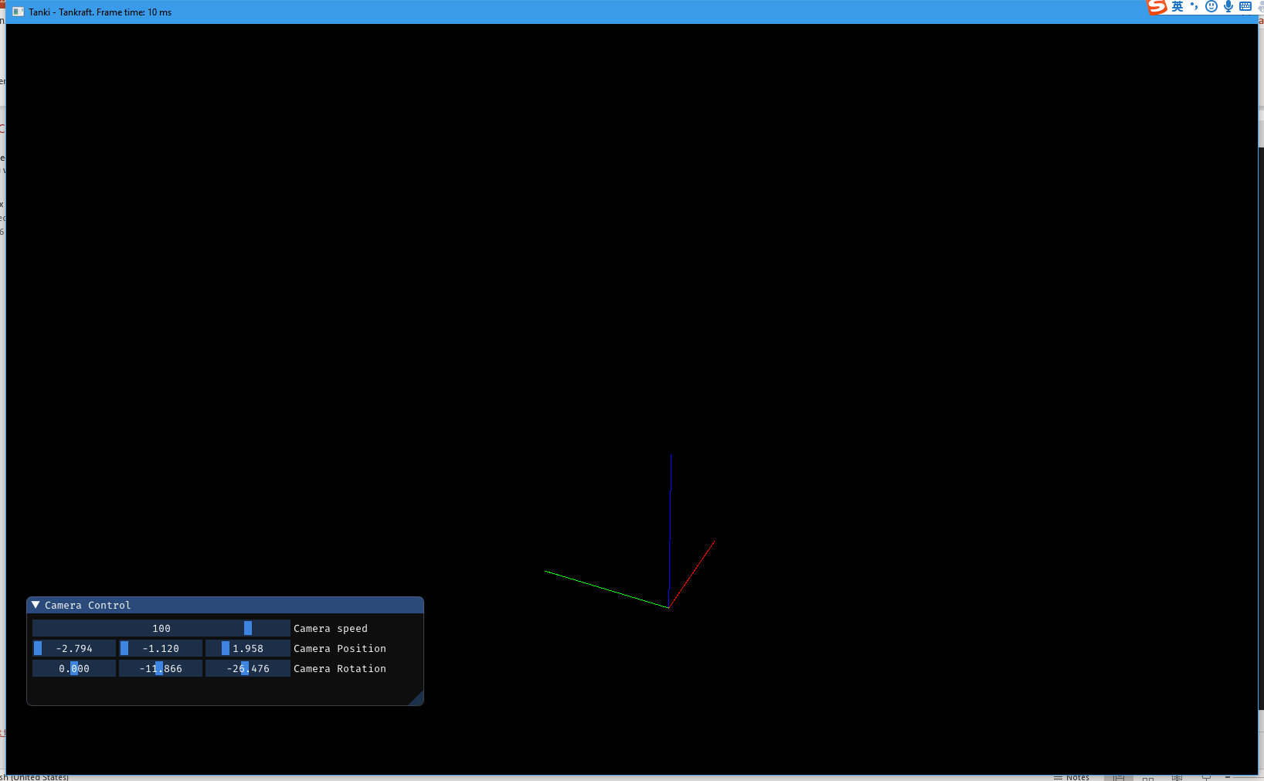

Slide 5
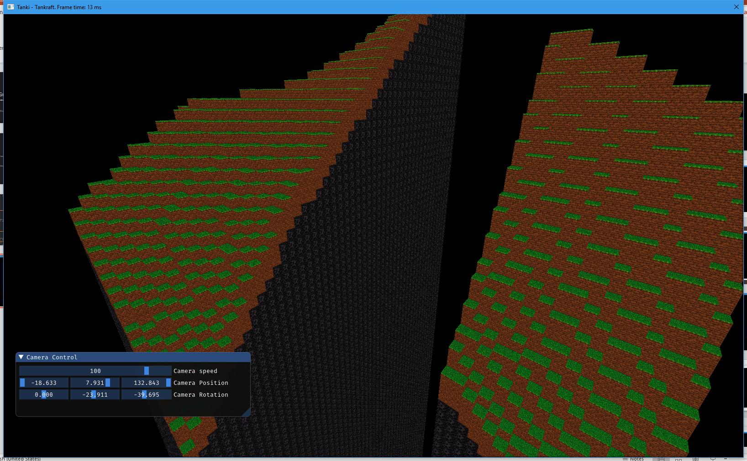

Slide 6
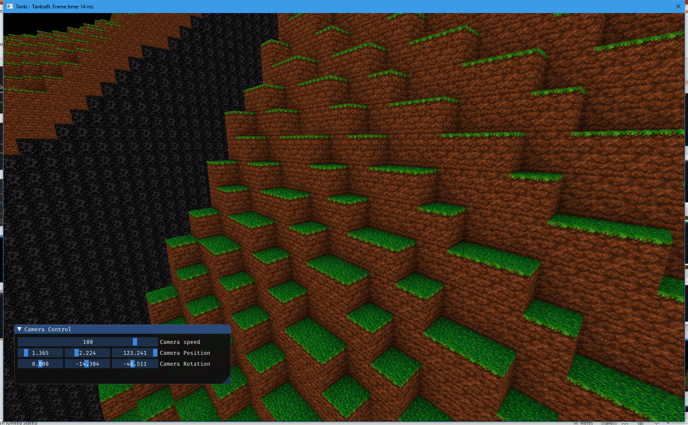

Slide 7
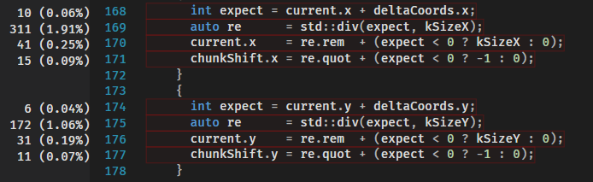
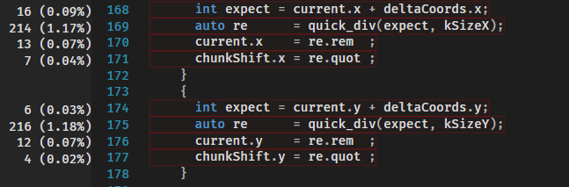
Quick Divide
static constexpr auto gNegativeDivLookUp = []() constexpr {
std::array<std::array<div_tt, kDivNumMax>, kDivDividerMax> arr;
for(int i = 0; i < kDivNumMax; i++) {
for(int j = 1; j < kDivDividerMax; j++) {
arr[j][i] = div_tt((-i % j) + j, i / j - 1);
}
}
return arr;
}();
div_tt quick_div(int num, int divider) {
if(abs(num) < kDivNumMax && divider < kDivDividerMax) {
if(num >= 0) {
return gPositiveDivLookUp[divider][num];
} else {
return gNegativeDivLookUp[divider][-num];
}
} else {
div_tt result;
auto re = std::div(num, divider);
result.rem = re.rem + (num < 0 ? divider : 0);
result.quot = re.quot + (num < 0 ? -1 : 0);
return result;
}
}

